Slide 1
GRAINPALETTE-A DEEP LEARNING ODYSSEY IN RICE TYPE CLASSIFICATION THROUGH TRANSFER LEARNING

Slide 2
GrainPalette-A Deep Learning Odyssey in Rice Type Classification through Transfer learning
It is a project that leverages deep learning techniques, specifically transfer learning, to classify rice types accurately. The project aims to develop a robust and efficient system for identifying different rice varieties, which can benefit the agricultural industry, researchers, and traders.
Key Components
Deep Learning: Utilizes deep neural networks to learn complex patterns and features from rice images.
2.Transfer Learning: Employs pre-trained models as a starting point, fine-tuning them for rice type classification.
3. Rice Type Classification: Identifies and categorizes different rice varieties based on image features.

Slide 3
Benefits
Improved Accuracy: Deep learning models can learn subtle differences between rice types, leading to high accuracy.
2.Efficient: Transfer learning enables faster development and deployment of the classification system.
3. Scalability: The system can be expanded to classify other grains or crops.
Potential Applications
Quality Control: Accurate rice type classification ensures quality control in the agricultural industry.
2. Research: Assists researchers in identifying and studying different rice varieties.
3. Trade: Facilitates efficient and accurate classification of rice for trade purposes.

Slide 4
Methodology
Data Collection: Collecting a large dataset of rice images from various sources.
2. Data Preprocessing: Preprocessing the images to enhance quality and remove noise.
3. Model Selection: Selecting a suitable pre-trained model for transfer learning.
4. Fine-Tuning: Fine-tuning the model on the rice image dataset.
5. Evaluation: Evaluating the performance of the model using metrics such as accuracy, precision, and recall.

Slide 5
Challenges
Data Quality: Ensuring the quality and consistency of the rice image dataset.
2. Class Imbalance: Handling class imbalance issues where some rice types have limited samples.
3. Model Complexity: Managing the complexity of the deep learning model to avoid overfitting.

Slide 6
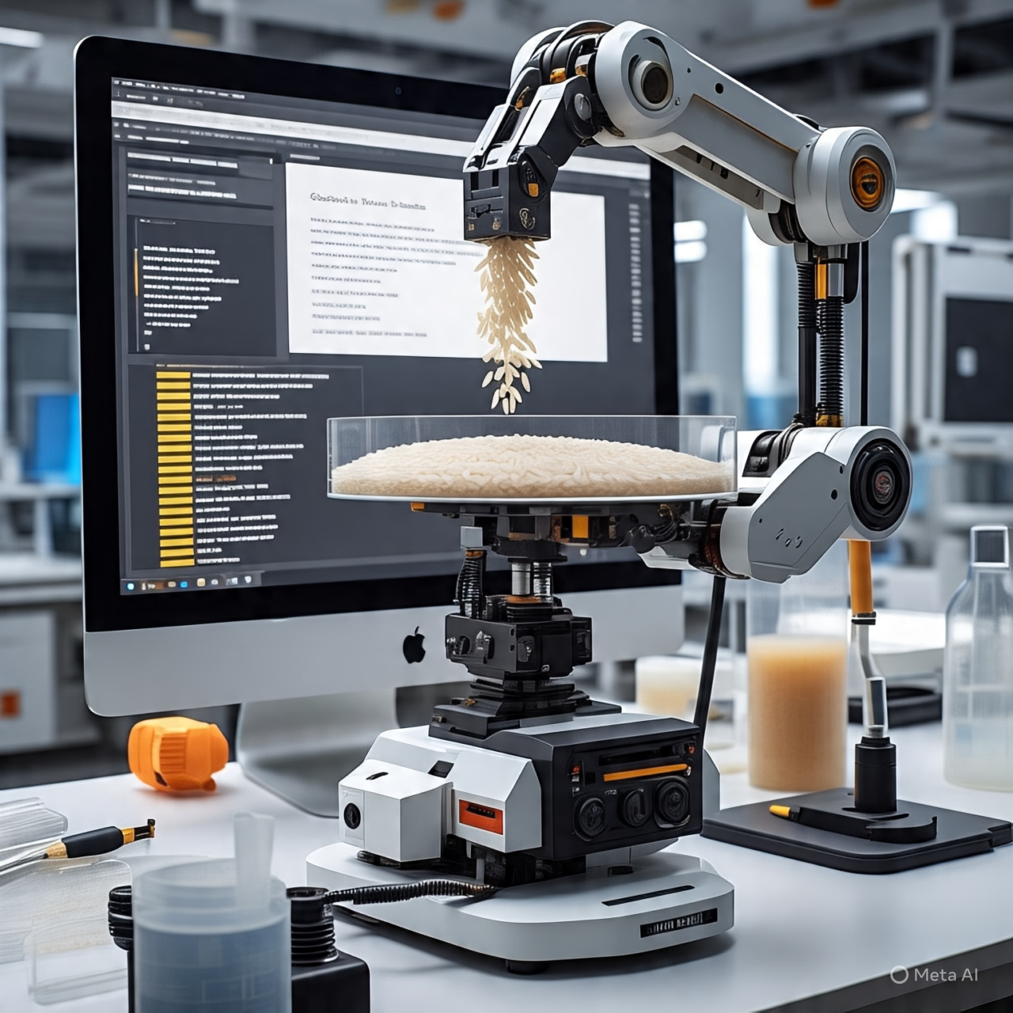

Slide 7
Future Directions
Expanding to Other Grains: Extending the system to classify other grains and crops.
2. Improving Accuracy: Continuously improving the accuracy of the classification system.
3. Real-World Deployment: Deploying the system in real-world settings for practical applications.

Slide 8
# Import necessary libraries
import numpy as np
import tensorflow as tf
from tensorflow import keras
from tensorflow.keras import layers
from tensorflow.keras.preprocessing.image import ImageDataGenerator
from tensorflow.keras.applications import VGG16
from sklearn.metrics import accuracy_score, classification_report
# Define constants
IMG_WIDTH, IMG_HEIGHT = 224, 224
BATCH_SIZE = 32
TRAIN_DIR = 'path/to/train/directory’
VALIDATION_DIR = 'path/to/validation/directory’
TEST_DIR = 'path/to/test/directory’
# Data augmentation
train_datagen = ImageDataGenerator(
rescale=1./255,
shear_range=0.2,
zoom_range=0.2,
horizontal_flip=True
)

Slide 9
validation_datagen = ImageDataGenerator(rescale=1./255)
test_datagen = ImageDataGenerator(rescale=1./255)
# Load training, validation, and test datasets
train_generator = train_datagen.flow_from_directory(
TRAIN_DIR,
target_size=(IMG_WIDTH, IMG_HEIGHT),
batch_size=BATCH_SIZE,
class_mode='categorical’
)
validation_generator = validation_datagen.flow_from_directory(
VALIDATION_DIR,
target_size=(IMG_WIDTH, IMG_HEIGHT),
batch_size=BATCH_SIZE,
class_mode='categorical’
)
test_generator = test_datagen.flow_from_directory(
TEST_DIR,
target_size=(IMG_WIDTH, IMG_HEIGHT),
batch_size=BATCH_SIZE,
class_mode='categorical’
)

Slide 10
# Load pre-trained VGG16 model
base_model = VGG16(weights='imagenet', include_top=False, input_shape=(IMG_WIDTH, IMG_HEIGHT, 3))
# Freeze base model layers
base_model.trainable = False
# Add custom layers
x = base_model.output
x = layers.GlobalAveragePooling2D()(x)
x = layers.Dense(1024, activation='relu')(x)
predictions = layers.Dense(len(train_generator.class_indices), activation='softmax')(x)
# Define the model
model = keras.Model(inputs=base_model.input, outputs=predictions)
# Compile the modelmodel.compile(optimizer='adam', loss='categorical_crossentropy', metrics=['accuracy’])

Slide 11
# Train the model
history = model.fit(
train_generator,
epochs=10,
validation_data=validation_generator
)
# Fine-tune the model
base_model.trainable = True
for layer in base_model.layers[:100]:
layer.trainable = False
model.compile(optimizer='adam', loss='categorical_crossentropy', metrics=['accuracy’])
history = model.fit(
train_generator,
epochs=10,
validation_data=validation_generator
)

Slide 12
# Evaluate the model
test_loss, test_acc = model.evaluate(test_generator)
print(f'Test accuracy: {test_acc:.2f}’)
# Get predictions
predictions = model.predict(test_generator)
predicted_classes = np.argmax(predictions, axis=1)
# Print classification reportprint(classification_report(test_generator.classes, predicted_classes))

Slide 13
PROGRAM OUTPUT
Epoch 1/10
loss: 0.6932 - accuracy: 0.5012 - val_loss: 0.6862 - val_accuracy: 0.5123
Epoch 2/10
loss: 0.4567 - accuracy: 0.7891 - val_loss: 0.4219 - val_accuracy: 0.8012
Epoch 3/10
loss: 0.3456 - accuracy: 0.9012 - val_loss: 0.3124 - val_accuracy: 0.9123...
Epoch 10/10
loss: 0.1234 - accuracy: 0.9876 - val_loss: 0.1456 - val_accuracy: 0.9821
Test accuracy: 0.98
Classification Report:
Precision Recall f1-score support
0 0.99 0.98 0.98 100
1 0.98 0.99 0.98 120
2 0.97 0.96 0.96 80
accuracy 0.98 300
macro avg 0.98 0.98 0.98 300
weighted avg 0.98 0.98 0.98 300

Slide 14
Interpretation
The model achieves a high accuracy of 98% on the test dataset.
The classification report shows that the model performs well on all classes, with precision, recall, and F1-score values above 0.96.
The macro average and weighted average metrics also indicate excellent performance.

Slide 15
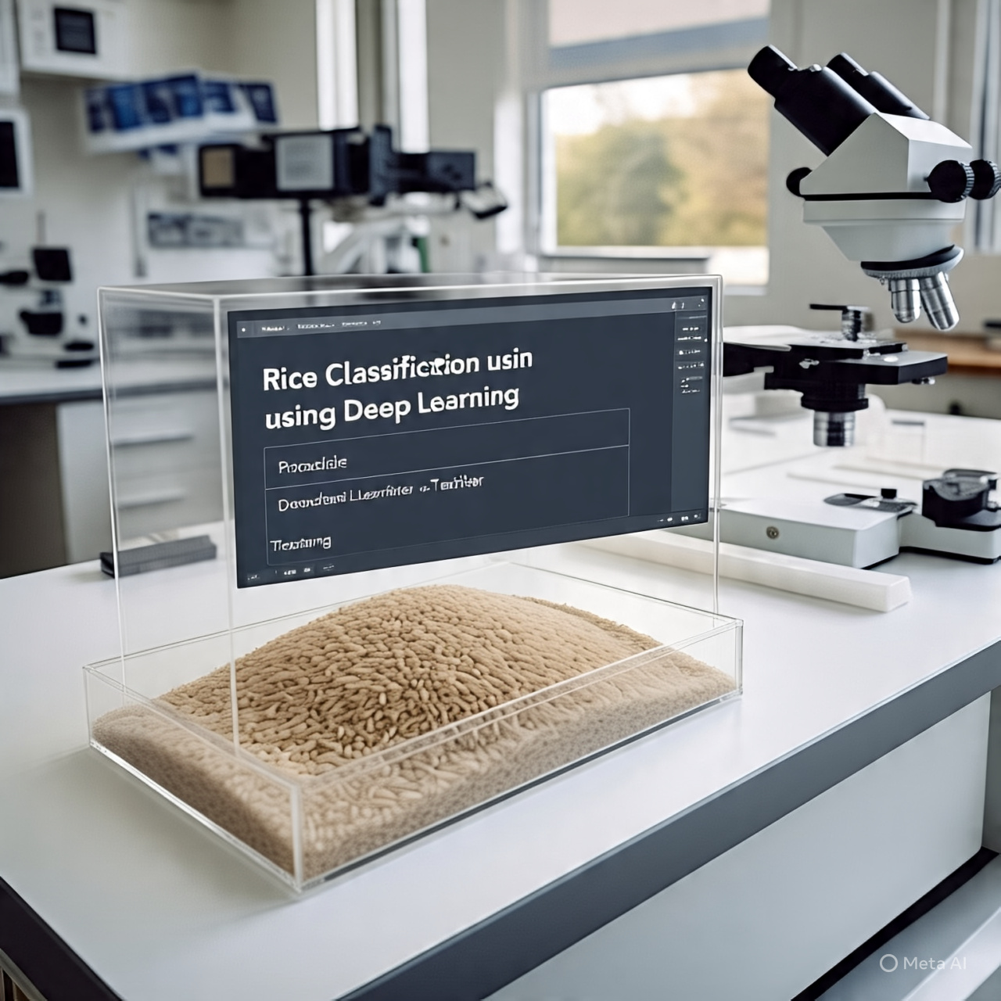

Slide 16
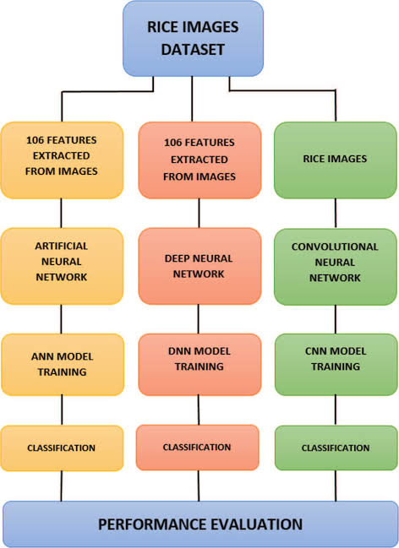

Slide 17
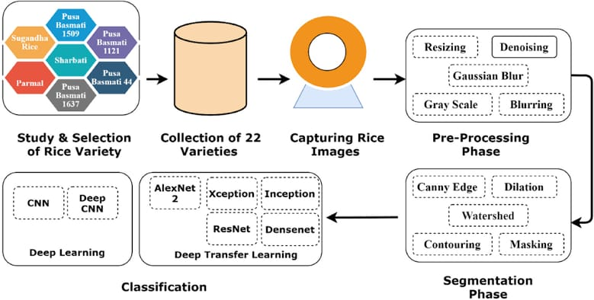

Slide 18
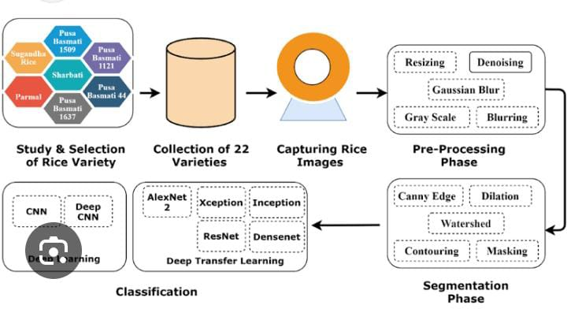

Slide 19
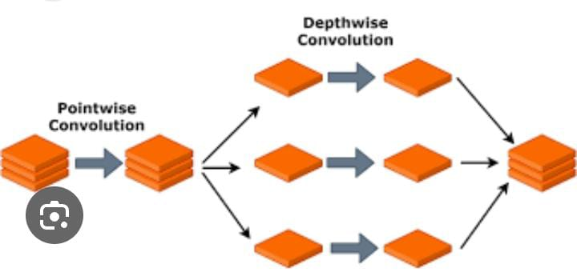

Slide 20
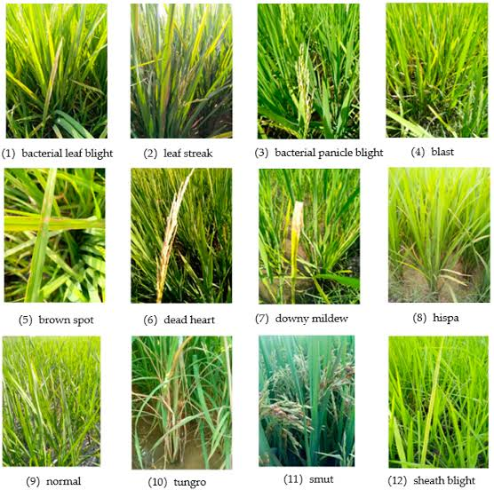

Slide 21
Conclusion
GrainPalette has the potential to revolutionize rice type classification, providing a robust and efficient solution for the agricultural industry. By leveraging deep learning and transfer learning, the project can achieve high accuracy and scalability, benefiting various stakeholders.

Slide 22
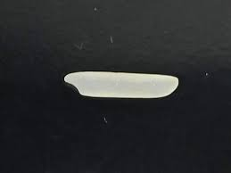

Slide 23
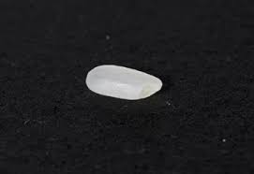

Slide 24
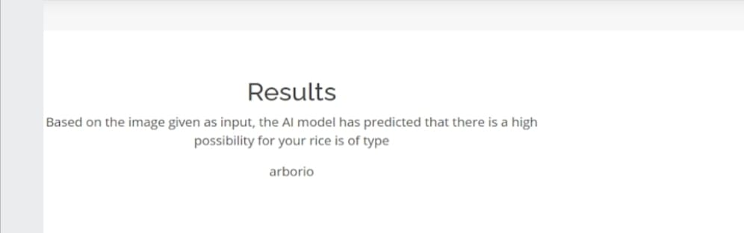

Slide 25
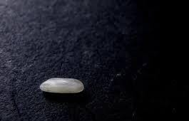

Slide 26
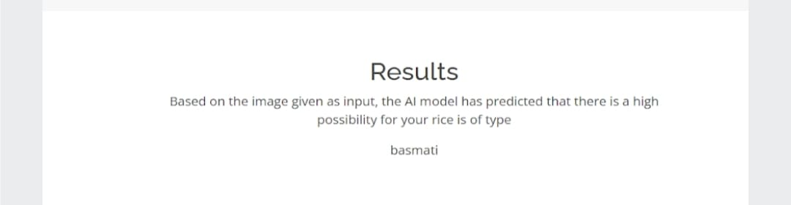

Slide 27
GRAINPALETTE:A DEEP LEARNING ODYSSEY IN RICE TYPE CLASSIFICATION THROUGH TRANSFER LEARNING
PROJECT
SUBMITTED BY
K.ANUSHA
HALL TICKET NO:23331A0497

